Slide 1

AtliQ Mart Consumer Goods
Analysis Report

Slide 2

Introduction
AtliQ Hardware (imaginary company) is one of the leading computer hardware producers in India and well expanded in other countries too.
However, the management noticed that they do not get enough insights to make quick and smart data-informed decisions.
Management asked some questions and based on their questions I provide some insights.

Slide 3
Query 1
Provide the list of markets in which customer "Atliq Exclusive" operates its business in the APAC region.
Market
India
Indonesia
Japan
Philiphines
South Korea
Australia
Newzealand
Bangladesh

Slide 4
Query 2
What is the percentage of unique product increase in 2021 vs. 2020? The final output contains these fields:
unique_products_2020
unique_products_2021
percentage_chg
Unique_products_2020 | Unique_products_2021 | percentage_chg
17034 | 16660 | 33.33%

Slide 5
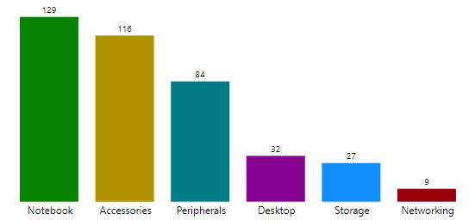
Query 3
Provide a report with all the unique product counts for each segment and sort them in descending order of product counts. The final output contains 2 fields,
segment
product_count
segment | product_count
Notebook | 129
Accessories | 116
Peripherals | 84
Desktop | 32
Storage | 27
Networking | 9

Slide 6
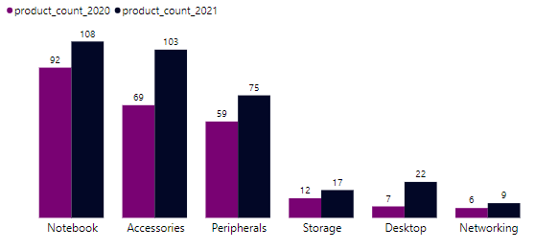
Query 4
Which segment had the most increase in unique products in 2021 vs 2020? The final output contains these fields,
segment
product_count_2020
product_count_2021
difference
segment | product_count_2021 | product_count_2020 | difference
Accessories | 103 | 69 | 34
Desktop | 22 | 7 | 15
Networking | 9 | 6 | 3
Notebook | 108 | 92 | 16
Peripherals | 75 | 59 | 16
Storage | 17 | 12 | 5

Slide 7
Query 5
Get the products that have the highest and lowest manufacturing costs. The final output should contain these fields,
product_code
product
manufacturing_cost
product_code | product | manufacturing_cost
A0118150101 | AQ Dracula HDD â€“ 3.5 Inch SATA 6 Gb/s 5400 RPM 256 MB Cache | 240.5364
A0118150101 | AQ Dracula HDD â€“ 3.5 Inch SATA 6 Gb/s 5400 RPM 256 MB Cache | 0.892

Slide 8
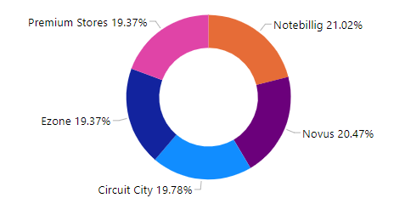
Query 6
Generate a report which contains the top 5 customers who received an average high pre_invoice_discount_pct for the fiscal year 2021 and in the Indian market. The final output contains these fields,
customer_code
customer
average_discount_percentage
customer_code | customer | average_discount_percentage
90012035 | Notebillig | 30.6
80006155 | Novus | 29.8
90022076 | Circuit City | 28.8
90002003 | Ezone | 28.2
90017049 | Premium Stores | 28.2

Slide 9
Query 7
Get the complete report of the Gross sales amount for the customer “Atliq Exclusive” for each month. This analysis helps to get an idea of low and high-performing months and take strategic decisions. The final report contains these columns:
Month
Year
Gross sales Amount
month | year | gross sales amount
September | 2019 | 1066548
October | 2019 | 991045
November | 2019 | 1115465
December | 2019 | 670126.8
January | 2020 | 1092488
February | 2020 | 910017.5
March | 2020 | 243903.8
April | 2020 | 198249.4
May | 2020 | 468716
month | year | gross sales amount
June | 2020 | 557983.5
July | 2020 | 973696
August | 2020 | 569510
September | 2020 | 1725996
October | 2020 | 1439452
November | 2020 | 1585373
December | 2020 | 923110.8
January | 2021 | 1731068
February | 2021 | 1402643
month | year | gross sales amount
March | 2021 | 1518630
April | 2021 | 887564.4
May | 2021 | 1741385
June | 2021 | 1403535
July | 2021 | 1520631
August | 2021 | 891262.7

Slide 10
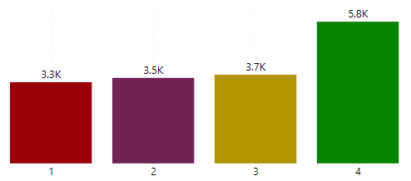
Query 8
In which quarter of 2020, got the maximum total_sold_quantity? The final output contains these fields sorted by the total_sold_quantity,
Quarter
total_sold_quantity
Quarter | total_sold_quantity
1 | 3343
2 | 3520
3 | 3650
4 | 5832

Slide 11
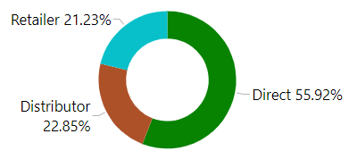
Query 9
Which channel helped to bring more gross sales in the fiscal year 2021 and the percentage of contribution? The final output contains these fields,
channel
gross_sales_mln
percentage
channel | gross_sales_mln | percentage
Direct | 2611 | 55.92
Distributor | 1067 | 22.85
Retailer | 991 | 21.23

Slide 12
Query 10
Get the Top 3 products in each division that have a high total_sold_quantity in the fiscal_year 2021? The final output contains these fields,
division
product_code
product
total_sold_quantity
rank_order
division | product_code | product | total_sold_quantity | rank_order
N & S | A7219160201 | AQ Wi Power Dx2 | 275328 | 1
N & S | A7220160203 | AQ Wi Power Dx2 | 277299 | 2
N & S | A7321160301 | AQ Wi Power Dx3 | 281363 | 3
P & A | A3920150304 | AQ LION x3 | 33523 | 1
P & A | A3718150102 | AQ LION x1 | 34022 | 2
P & A | A3718150105 | AQ LION x1 | 34080 | 3
PC | A6018110106 | AQ Home Allin1 | 2281 | 1
PC | A6119110202 | AQ HOME Allin1 Gen 2 | 2285 | 2
PC | A6119110204 | AQ HOME Allin1 Gen 2 | 2286 | 3

Slide 13

- by Dibyendu Biswas

